Slide 1
Op-Alert:
A project by
Michael Lissner and Longhao Wang
under the advisement of
Brian Carver
for partial fulfillment of
Master of Information
Management and Systems

Slide 2
Op-Alert:
Status Report, 12 March 2010
MoSCoW plan complete
Now on my own
Scrapers nearly complete
Search engine analysis done
Risks: SQL and Sphinx

Slide 3
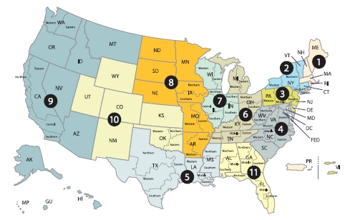
Op-Alert: Background
There are 13 federal appellate courts.
  They issue judicial opinions every day.
  These opinions can vastly change the legal landscape.

Slide 4
Op-Alert: Background
In 2008 there were 1.1M licensed lawyers in the U.S.*
  Each must get information from somewhere.
  There are also academics, bloggers, journalists, and the general public to consider.
But LexisNexis and Westlaw are expensive.
  Also, neither provides a very good alert system.
* Source: American Bar Association, lawyer demographics

Slide 5
The Op-Alert Solution
Scrape the court websites every day.
Users create queries to trigger alerts
  For example: (copyright OR trademark) circuit:9 judge:Kozinski
Notify people when their alert has a hit.
Technologies:
  Boolean interpreter
  Tokenization and stemming
  LAMP running django

